Slide 1
Lecture 5: Simple spatial models for coastlines
April 24, 2018
Notes:
Homework 3
Chaotic dynamics makes inner optimizer fail a lot (machine rounding error)
Gompertz model is linear so it will always be fine, Ricker gets chaotic
Constrain fixed parameters using upper and lower arguments in call to TMBhelper::optimize
But no way to change the random effects constraints
Get good starting values by fitting a reduced model (aka “sculpting” in admb land) and then using them as starting values
This class:
Speparable vs nonseparable

Slide 2
Why might we care about 1D spatial models?
Coastlines
Distances towards/away from an experiment
Introduction to other 1D models…
Notes:
Time series is a 1D process model
But in general, time is discrete (by year, so we can skip over seasonal issues)
Jim Clark tree ecologist

Slide 3
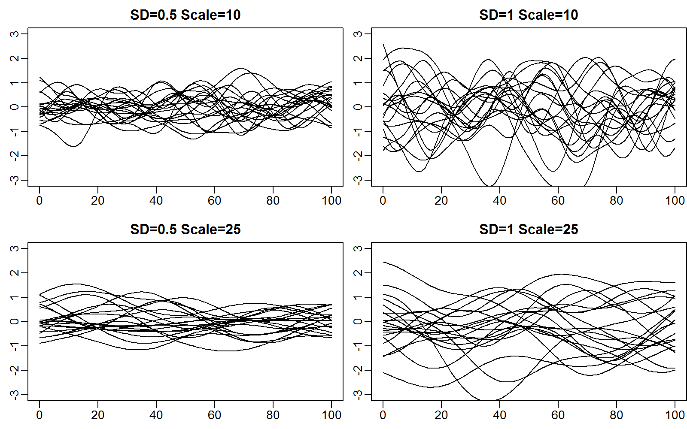

Gaussian process
$$ℰ\sim GP(0,𝒞)$$
Notes:
Previously, random variables or random vectors
Continuous version is random function
Epsilon is a random function
GP input is two functions, mean function (zero function here) and covariance function (takes two locations as input and gives the expected (?) covariance at those locations)
RV has mean and variance
Differentiable function has three moments
Decorrelation distance is third moment (scale)
Generated using random field

Slide 4

Gaussian process
$$ℰ\sim GP(0,𝒞)$$
Then…
$$ε\sim MVN\left(0,Σ\right)$$
…which means…
$$p\sim MVN(f\left(b;θ\right),Σ)$$
Surplus production
Spawning biomass relative to unfished equilibrium
Notes:
GP soaks up model misspecification (red line)
Vs blue line that is a parametric specification
When predictions are functions, you can predict at any continuous location at any scale

Slide 5

Coastline (sites are blue circles)
Imagine that:
$$c\left(s\right)\sim g\left(μ(s)\right)$$
Where $c\left(s\right)$is a count sample at site s
where $g$ is the observation distribution and $μ(s)$is the expected value
You have three density samples per site
Strategies:
Blocking (fixed or random)
Equal-distance autoregression
Unequal-distance autoregression
Notes:
Blocking N/S or site
Equal distance auto-regression—like doing the Kalman filter (block things up)
Unequal distances—that’s what we do tomorrow

Slide 6
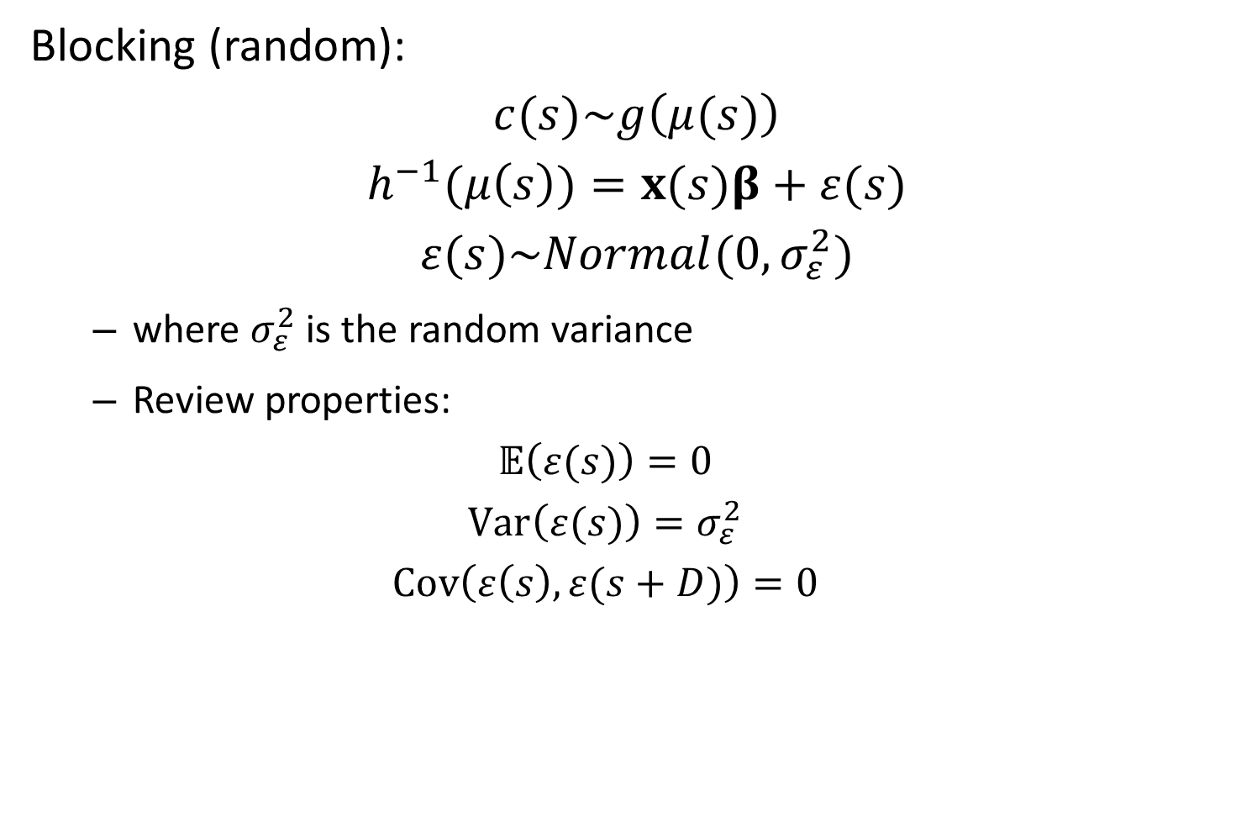
Blocking (random):
$$c(s)\sim g\left(μ(s)\right)$$
$$h^{−1}(μ\left(s\right))=x(s)β+ε(s)$$
$$ε(s)\sim Normal(0,σ_{ε}^{2})$$
where $σ_{ε}^{2}$ is the random variance
Review properties:
$$𝔼\left(ε(s)\right)=0$$
$$Var\left(ε(s)\right)=σ_{ε}^{2}$$
$$Cov\left(ε\left(s\right),ε(s+D)\right)=0$$

Slide 7

Equal distance autoregression
$$c(s)\sim g\left(μ(s)\right)$$
$$μ\left(s\right)=x(s)β+ε(s)$$
Let’s assume first-order autoregression:
$$ε(s+1)\sim Normal(ρε(s),σ_{ε}^{2})$$
We therefore replace distance by ordering
Notes:
Epsilon is a GP
X is a covariate defined at all the places
Here—equal distances, no interpolation

Slide 8
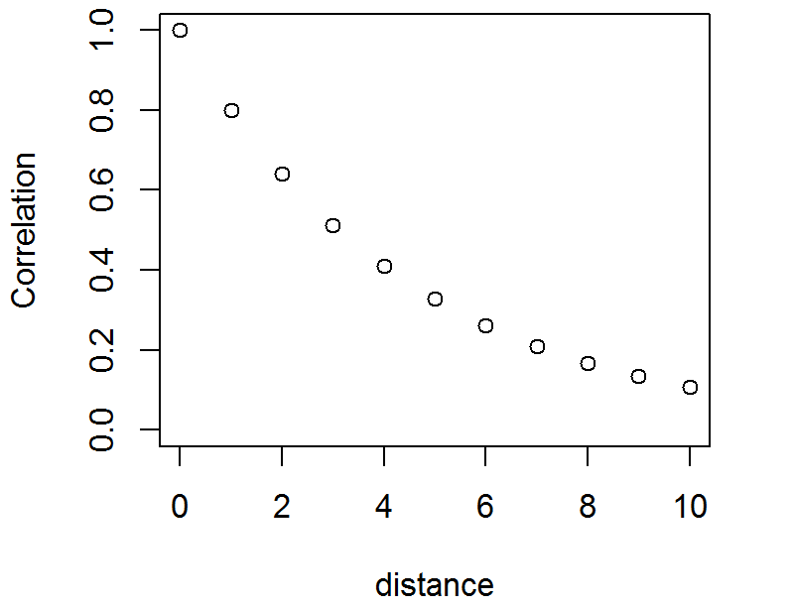

Equal distance autoregression
$$c(s)\sim g\left(μ(s)\right)$$
$$μ\left(s\right)=x(s)β+ε(s)$$
Let’s assume first-order autoregression:
$$ε(s+1)\sim Normal(ρε(s),σ_{ε}^{2})$$
Notes:
Correlation is an Exponentially decreasing function

Slide 9
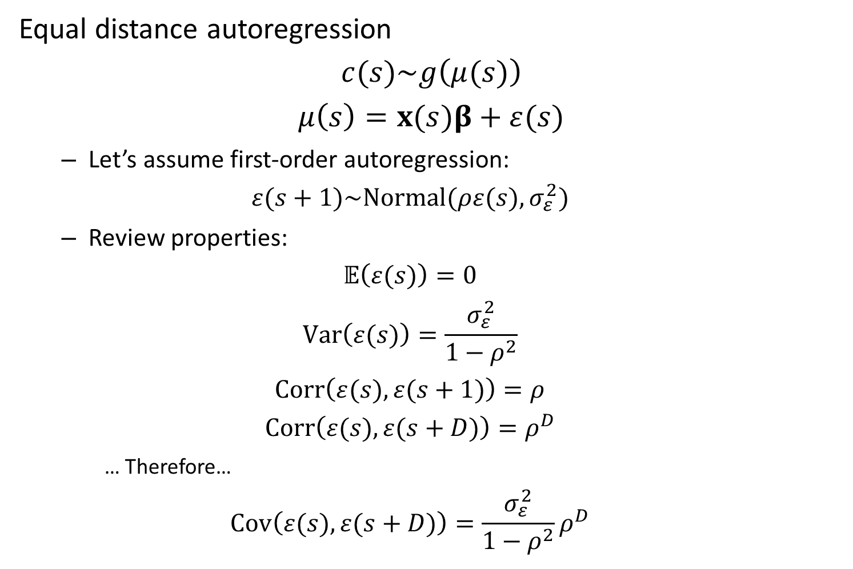
Equal distance autoregression
$$c(s)\sim g\left(μ(s)\right)$$
$$μ\left(s\right)=x(s)β+ε(s)$$
Let’s assume first-order autoregression:
$$ε(s+1)\sim Normal(ρε(s),σ_{ε}^{2})$$
Review properties:
$$𝔼\left(ε(s)\right)=0$$
$$Var\left(ε(s)\right)=\frac{σ_{ε}^{2}}{1−ρ^{2}}$$
$$Corr\left(ε(s),ε(s+1)\right)=ρ$$
$$Corr\left(ε(s),ε(s+D)\right)=ρ^{D}$$
… Therefore…
$$Cov\left(ε(s),ε(s+D)\right)=\frac{σ_{ε}^{2}}{1−ρ^{2}}ρ^{D}$$
Notes:
Rho between -1 and 1, convergent power series
Total covariance is marginal variance time correlation (“marginal” in there somewhere)
Way 1 to write
E(s +1) is recursive formuations

Slide 10
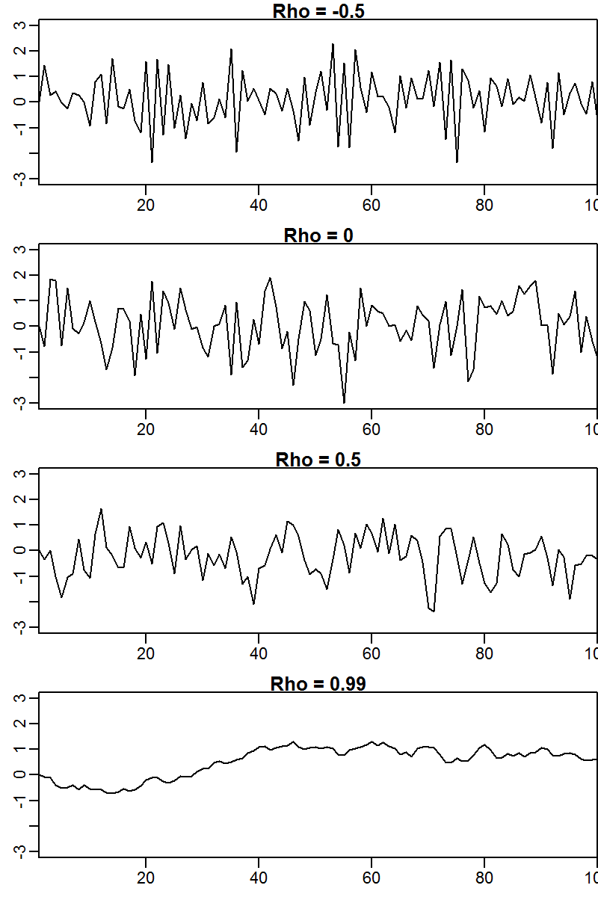
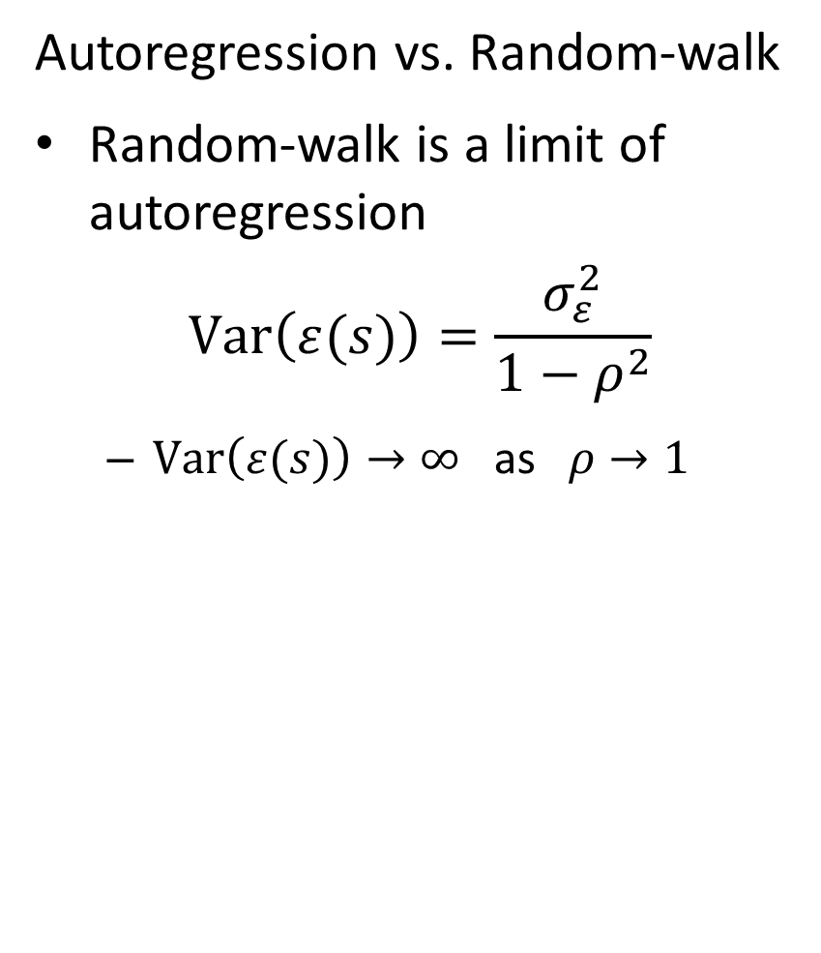
Autoregression vs. Random-walk
Random-walk is a limit of autoregression
$$Var\left(ε(s)\right)=\frac{σ_{ε}^{2}}{1−ρ^{2}}$$
$Var\left(ε(s)\right)→∞$ as $ρ→1$
Notes:
Stops having a stationary distribution as rho gets big

Slide 11

Equal distance autoregression
$$c(s)\sim g\left(μ(s)\right)$$
$$μ\left(s\right)=x(s)β+ε(s)$$
Then…
$$ε\sim MVN(0,Σ)$$
where
Notes:
Left hand term is marginal variance
Second way to write eplison (non-recursive formula)

Slide 12
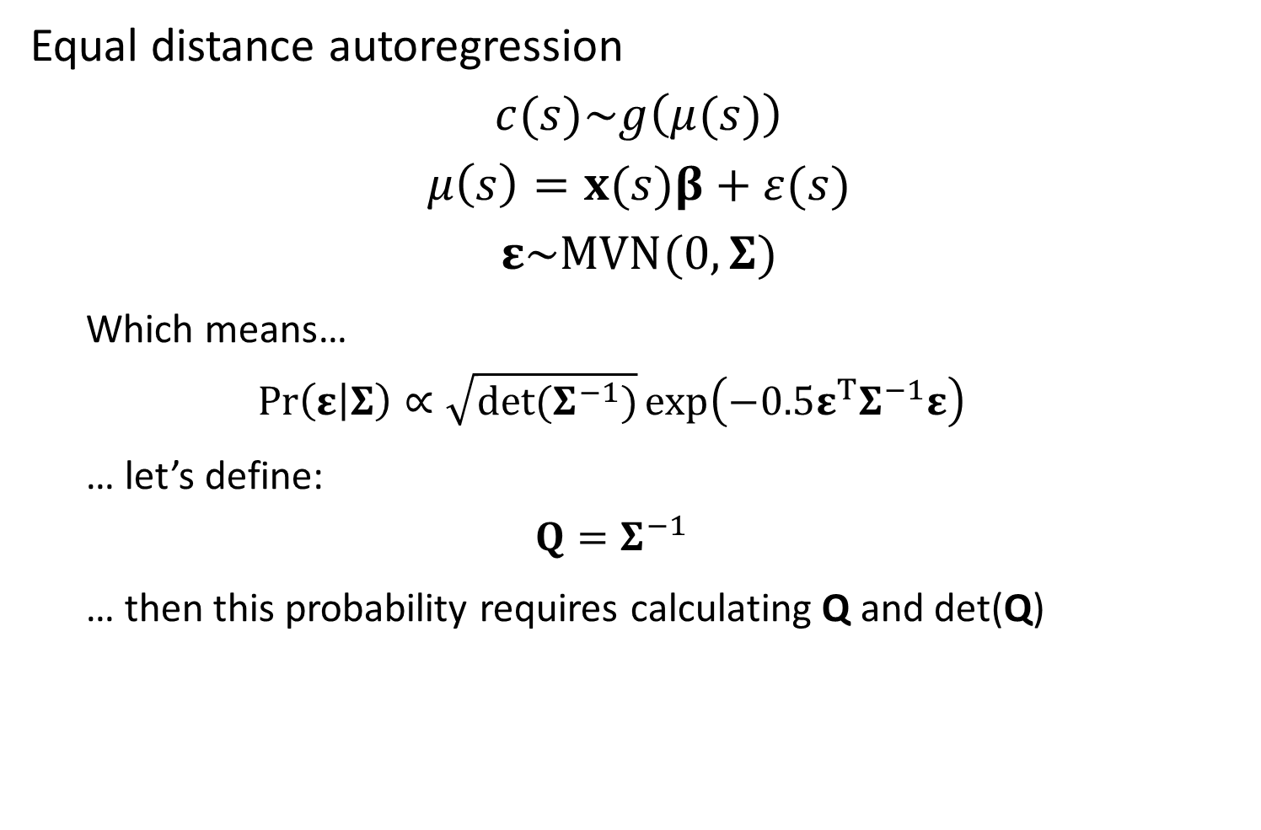
Equal distance autoregression
$$c(s)\sim g\left(μ(s)\right)$$
$$μ\left(s\right)=x(s)β+ε(s)$$
$$ε\sim MVN(0,Σ)$$
Which means…
$$\operatorname{Pr}\left(ε | Σ\right)∝\sqrt{det(Σ^{−1})}\exp\left(−0.5ε^{T}Σ^{−1}ε\right)$$
… let’s define:
$$Q=Σ^{−1}$$
… then this probability requires calculating Q and det(Q)
Notes:
Formula for MVN pdf is there
Only ever deals with inv variance, we we’ve been calling Q, the precision matrix
To evaluate MVN, we need Q and it’s determinant, which are computationally challenging

Slide 13

Equal distance autoregression
$$c(s)\sim g\left(μ(s)\right)$$
$$μ\left(s\right)=x(s)β+ε(s)$$
$$ε\sim MVN(0,Σ)$$
Fortunately its easy to calculate $Q=Σ^{−1}$:
Notes:
A third approach, code inv covariance directly (aka partial covariance matrix) effect of element i on element j after getting rid of other variables
Then we hand code Q
CAR model formula (contditional autoregressive)

Slide 14
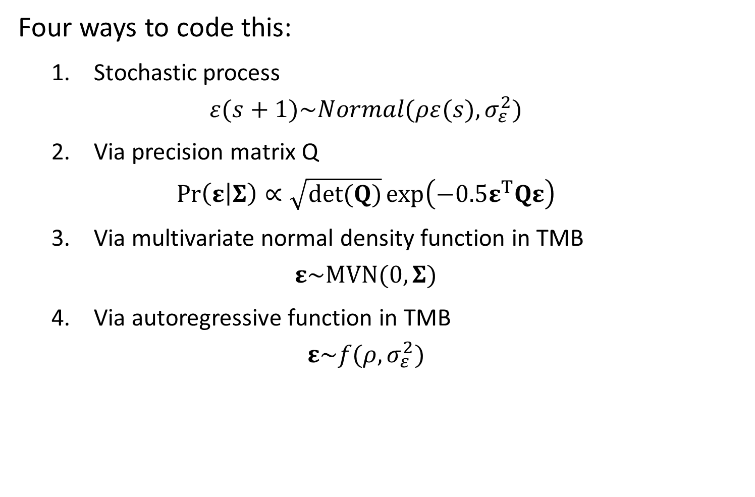
Four ways to code this:
1. Stochastic process
$$ε(s+1)\sim Normal(ρε(s),σ_{ε}^{2})$$
2. Via precision matrix Q
$$\operatorname{Pr}\left(ε | Σ\right)∝\sqrt{det(Q)}\exp\left(−0.5ε^{T}Qε\right)$$
3. Via multivariate normal density function in TMB
$$ε\sim MVN(0,Σ)$$
4. Via autoregressive function in TMB
$$ε\sim f(ρ,σ_{ε}^{2})$$
Notes:
Final fourth way is TMB’s built in function to use
Let’s look at tmb code that does all of these things. They give the same results, but behave differently in terms of speed and memory

Slide 15
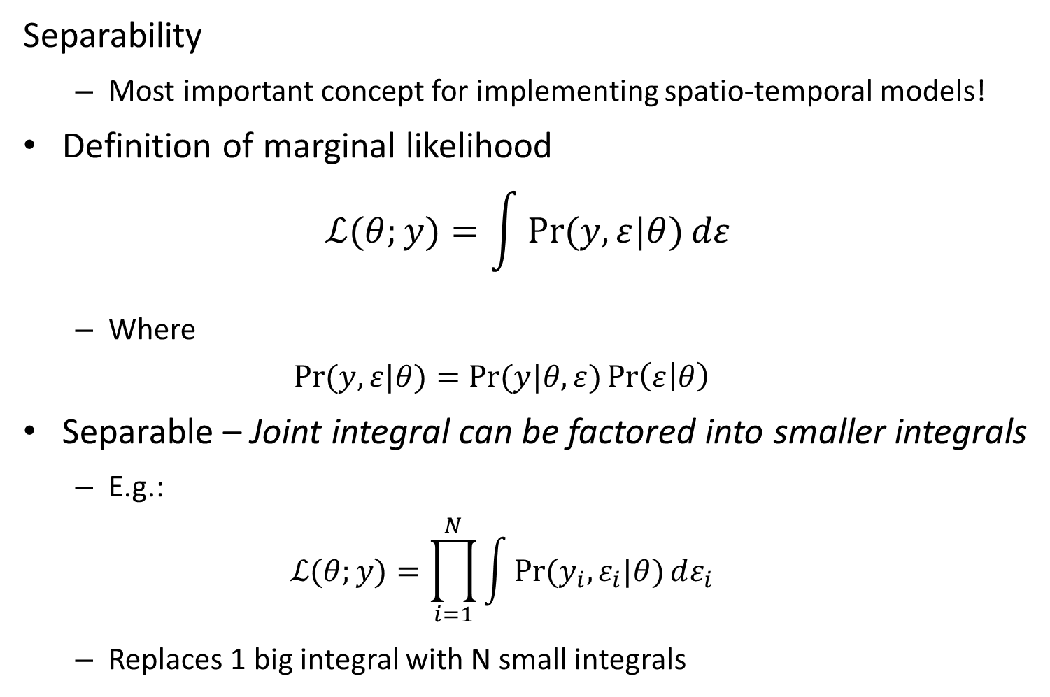
Separability
Most important concept for implementing spatio-temporal models!
Definition of marginal likelihood
$$ℒ(θ;y)=\int{\operatorname{Pr}{(y,ε|θ)}dε}$$
Where
$$\operatorname{Pr}{(y,ε|θ)}=\operatorname{Pr}{(y|θ,ε)}\operatorname{Pr}\left(ε | θ\right)$$
Separable – Joint integral can be factored into smaller integrals
E.g.:
$$ℒ(θ;y)=\prod_{i=1}^{N}{\int{\operatorname{Pr}{(y_{i},ε_{i}|θ)}dε_{i}}}$$
Replaces 1 big integral with N small integrals
Notes:
Multivariate integral to calc marginal likelihood
Better if we can split it up into smaller things
Epsilon is dimension = locations at which random effects are evaluated
Example of 10 random effects that can be blocked out into 10 different integrals
Kalman filter MVN → one dimensional ran efs
Other block hessians we’ve seen: HW2 with random effect for each site + multiple obs per site– could do integral for each site (because given site, obs are independent)

Slide 16
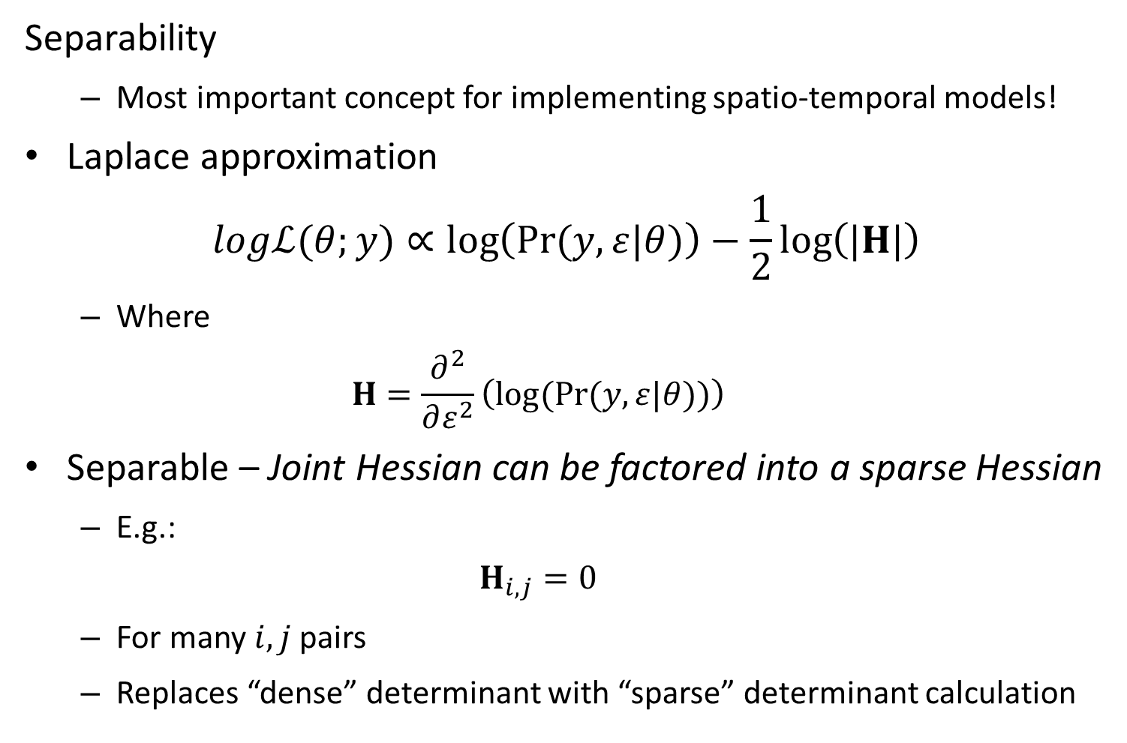
Separability
Most important concept for implementing spatio-temporal models!
Laplace approximation
$$logℒ(θ;y)∝\log\left(\operatorname{Pr}{(y,ε|θ)}\right)−\frac{1}{2}\log\left(|H|\right)$$
Where
$$H=\frac{∂^{2}}{∂ε^{2}}\left(log⁡(\operatorname{Pr}{(y,ε|θ)})\right)$$
Separable – Joint Hessian can be factored into a sparse Hessian
E.g.:
$$H_{i,j}=0$$
For many $i,j$pairs
Replaces “dense” determinant with “sparse” determinant calculation
Notes:
Another way to think about separability is the structure of the Hessian
If it has sub-blocks with zeros between, then we can break up the integrals

Slide 17
[Show R and TMB code for 4 ways to code this, specifically looking at sparseness of hessian matrix]

Slide 18
Lessons:
Speed
Stochastic process (Version #1) is faster
Often easiest to program stochastic process as well
Why use other versions?
Others are easier to “scale up”
Eventually we’ll use SEPERABLE() to admix different processes
Others may be faster in other software
JAGS doesn’t have speed-ups for interpreting stochastic processes

Slide 19
Extensions
Time-series analysis with equal time intervals
Obvious link to temporal models
1D autoregression with unequal intervals
Important for coastline with intermittent field sites
1D space and 1D time
Simplest spatio-temporal model structure

